Slide 1
Applied Deep Learning
Homework 2
Kaggle Due: 2022/11/09 23:59
Code/Report Due: 2022/11/11 23:59

Slide 2
Links
NTU COOL
討論區
說明影片
adl-ta@csie.ntu.edu.tw
TA Hours:
星期二 3:00 pm ~ 4:30pm @ Google Meet (Online)
星期四 4:00 pm ~ 5:30pm @ Google Meet (Online)

Slide 3
Change Log
如果有更新的資訊 會公布在此！
Kaggle名稱請包含學號，否則沒辦法給分

Slide 4
Change Log
如果有更新的資訊 會公布在此！
降低Strong Baseline的分數，請同學在public盡量衝高一點(0.79以上較為保險)，避免private沒有過Strong Baseline
https://huggingface.co/luhua/chinese_pretrain_mrc_macbert_large不能當成這次hw2的pretrain model（因為fine-tune過MRC Data
https://huggingface.co/NchuNLP/Chinese-Question-Answering不能當成這次hw2的pretrain model
有同學尋問Kaggle有出現98%的成績？
這個情況似乎是因為有些同學不小心使用到pretrain在這次作業的dataset上的pretrain model，這樣在這次作業是不允許的

Slide 5
Change Log
如果有更新的資訊 會公布在此！
Huggingface上的pretrain model請不要使用訓練過QA或NLI data的model !!!
Transformer的tokenizer可以直接載嗎？還是要另外存在dropbox?因為助教有說會斷網，所以不是很確定，再麻煩助教回覆了，謝謝?
因為執行時會斷網，請另外存在 dropbox，可以使用 tokenizer.save_pretrained 來儲存你的 tokenizer !!!
因為重新上傳檔案，NTU COOL自懂產生-1或-2的檔名是沒關係的

Slide 6
Change Log
如果有更新的資訊 會公布在此！
剛好遇到期中考週，Deadline延後一週（請看NTU COOL公告確認最新繳交日期）
如果遇到predict出1,234，建議可將1,234變成"1,234"，加上""就可以讓kaggle正確判斷
建議如果使用huggingface github的script，可以使用no_trainer的sample code eg: run_swag_no_trainer.py(context selection) 和 run_qa_no_trainer.py(QA)
如果遇到Huggingface transformers example有check_min_version("4.24.0.dev0")，註解掉這一行即可
如果使用run_qa_no_trainer.py遇到error，建議可以在931行加上下面這一行程式碼
predict_dataloader = accelerator.prepare(predict_dataloader)
建議可以試試看將--max_length設為512(>384)

Slide 7
Outline
Task Description
Logistics
Rules
Report

Slide 8
Task Description

Slide 9
Chinese Question Answering
Input: Context list
"鼓是一種打擊樂器，...，最早的鼓出現於西元前六千年的兩河文明"
"盧克萊修生於共和國末期，...，被古典主義文學視為經典"
"視網膜又稱視衣，...，約3mm2大的橢圓。"
Input: Question
"最早的鼓可以追溯至什麼古文明?"
Output: Answer
"兩河文明"

Slide 10
Properties
Model should predict the answer given contexts and a question.
The answer is always a span in one of the contexts.
This task can be decomposed into 2 tasks:
Context selection: determine which context is relevant.
Span selection: determine the start and end position of the answer span in the context.

Slide 11
Metrics
Exact Match (EM)
1 if prediction and answer are the same after preprocessing, 0 if they are different.

Slide 12
Data
Context data
context.json
Labeled Data
Training set: train.json
Validation set: valid.json (You can use this file for training model or only for validation)
Unlabeled Data
Testing set: test.json
Sample Submission
sample_submission.csv
Check NTU COOL homework 2 page for download link.

Slide 13
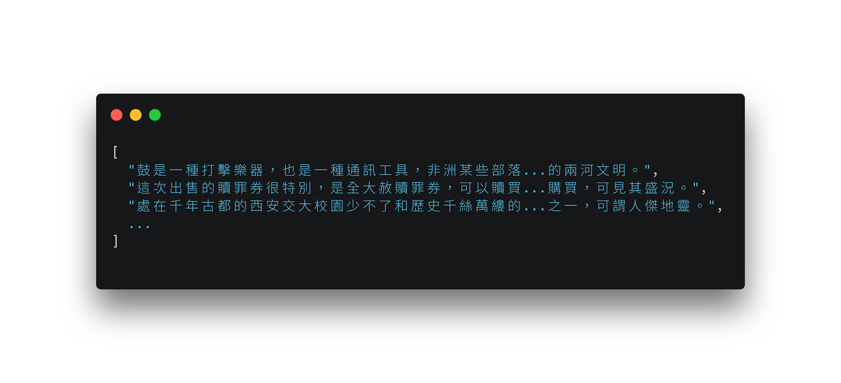
Data Format - context.json
list of short paragraphs

Slide 14
Data Format - questions
id: question ID
question: question text
paragraphs: list of 4 paragraph IDs (0-based)
relevant: ID of the relevant context (0-based) (* absent in test.json)
answer: answer to the question (* absent in test.json)
text: the answer text
start: answer span start position in the relevant context

Slide 15
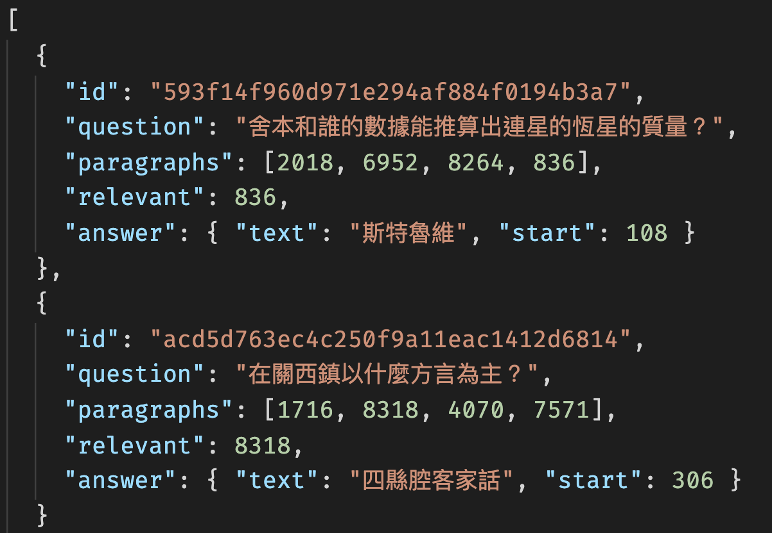
Data Format - questions

Slide 16
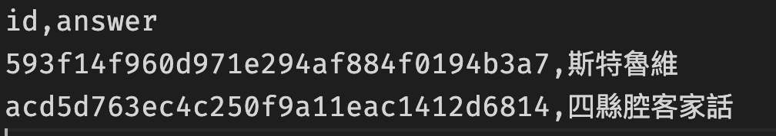
Submission Format
A CSV file whose header is id,answer
See sample_submission.csv
Example

Slide 17
Objective
Fine-tune a pre-trained Chinese BERT-based model on the dataset and pass the baselines.
Simple Baseline - (bert-base-chinese would be enough)
EM: Public 0.73508 (on Kaggle)
Strong Baseline - (You might need to explore other pretraining models)
EM: Public 0.77396 (on Kaggle)
For this homework, you can utilize the huggingface transformers package and pretrained model. You can adapt their example scripts to our task

Slide 18
Logistics

Slide 19
Grading
Model Performance (10%)
Your model passes the simple baseline on the public test set (2%) and the private test set (3%) on kaggle
Your model passes the strong baseline on the public test set (2%) and the private test set (3%) on kaggle
0 point if we can’t reproduce your submission using run.sh
Format (1%)
TA can run the grading script without human intervention.
Report (9% + 2% Bonus)
In PDF format!

Slide 20
Code/Scripts/Report/Result Submission
Zip your folder into a single .zip file.
Submit to NTU Cool.

Slide 21
File Layout
Your zip must contain files (case sensitive):
/[student id (lower-cased)]/, ex. /r12922000/, no brackets
run.sh
README.md
report.pdf
download.sh
Any other code/script.
Do not upload training, validation, testing data and model to COOL.

Slide 22
Submission Files - download.sh
download.sh to download your model.
Do not modify your file after deadline, or it will be seen as cheating.
Keep the URLs in download.sh valid for at least 2 weeks after deadline.
Do not do things more than downloading. Otherwise, your download.sh may be killed.
You can download at most 4G, and download.sh should finish within 1 hour. (At csie dept with maximum 10MB/s bandwidth)
You can upload your model to Dropbox. (see tutorial)
You can use gdown to download you model from Google Drive (please make sure we have the access to download)
We will execute download.sh before predicting scripts.

Slide 23
Submission Files - Scripts
run.sh
Arguments:
"${1}": path to the context file.
"${2}": path to the testing file.
"${3}": path to the output predictions.
TA will predict testing data as follow:
bash ./download.sh
bash ./run.sh /path/to/context.json /path/to/test.json /path/to/pred/prediction.csv
Specify the Python version (3.8 or 3.9) in the .sh file.
Default python version would be 3.8
Ex. python3.8 predict.py … / python3.9 predict.py … “python” would be python3.8
Make sure your code works!

Slide 24
Submission Files - Reproducibility
All the code you used to train, predict, plot figures for the report should should be uploaded.
README.md
Write down how to train your model with your code/script specifically.
If necessary, you will be required to reproduce your results based on the README.md.
If you cannot reproduce your result, you may lose points.
You will get at least - 2 penalty if you have no or empty README.md.

Slide 25
Execution Environment
Will be run on computer with
Ubuntu 20.04
32 GB RAM, GTX 3070 8G VRAM, 20G disk space available.
the packages we allow only.
python 3.8 / 3.9
Time limit: 2 hours for run.sh in total
No network access when predicting (after we run download.sh).
You will lose (some or all) your model performance score if
your script is at wrong location, or cause any error.

Slide 26
Rules

Slide 27
What You Can Do
Train with the data we give you.
Use publicly available pre-trained BERTs and their variants.
Use the packages/tools we allow:
Python 3.8 / 3.9 and Python Standard Library
PyTorch 1.12.1, TensorFlow 2.10.0
Tqdm,numpy, pandas, scikit-learn 1.1.2, nltk 3.7
transformers==4.22.2, datasets==2.5.2, accelerate==0.13.0
Dependencies of above packages/tools.
If you want to use other package, COOL/mail TA.

Slide 28
What You Can NOT Do
Any means of cheating or plagiarism, including but not limited to:
Use others' code from anywhere (e.g. web, github, classmate, etc.).
Use the labels of the test data directly or indirectly. (Do not try to find them.)
Use package or tools not allowed.
Use model trained with other QA/NLI data (If not sure, ask TA first).
Give/get model prediction to/from others.
Give/get trained model to/from others.
Publish your code before deadline.
Submit to past Kaggle competitions.
Violation may cause zero/negative score and punishment from school.

Slide 29
Submission Policy
Submit to NTU Cool.
No Late submission.

Slide 30
Report

Slide 31
You may lose score if TA has difficulty understanding it.
Please write in a human-readable way.

Slide 32
When Describing Model
Please limit the use of imprecise words.
Use equation whenever possible.
Descriptions which is imprecise or hard to understand may cause loss of points.
Ex.
bad: Feed the embedding of the sentence into a LSTM.
good: h_{t}, c_{t} = LSTM(w_{t}, h_{t-1}, c_{t-1}), where w_{t} is the word embedding of the t-th token.

Slide 33
Q1: Data processing (2%)
Tokenizer (1%):
Describe in detail about the tokenization algorithm you use. You need to explain what it does in your own ways.
Answer Span (1%):
How did you convert the answer span start/end position on characters to position on tokens after BERT tokenization?
After your model predicts the probability of answer span start/end position, what rules did you apply to determine the final start/end position?

Slide 34
Q2: Modeling with BERTs and their variants (4%)
Describe (2%)
your model (configuration of the transformer model)
performance of your model.
the loss function you used.
The optimization algorithm (e.g. Adam), learning rate and batch size.
Try another type of pretrained model and describe (2%)
your model
performance of your model
the difference between pretrained model (architecture, pretraining loss, etc.)
For example, BERT -> xlnet, or BERT -> BERT-wwm-ext. You can find these models in huggingface’s Model Hub.

Slide 35
Q3: Curves (1%)
Plot the learning curve of your QA model
Learning curve of loss (0.5%)
Learning curve of EM (0.5%)
You don’t need to calculate the metrics in every iteration. Please make sure there are at least 5 data points in each curve.

Slide 36
Q4: Pretrained vs Not Pretrained (2%)
Train a transformer model from scratch (without pretrained weights) on the dataset (you can choose either MC or QA)
Describe
The configuration of the model and how do you train this model
the performance of this model v.s. BERT
Hint: you can use the same training script for this problem, just skip the part where you load the pretrained weights
Hint: the model size configuration for BERT might be too large for this problem, if you find it hard to train a model of the same size, try to reduce model size (num_layers, hidden_dim, num_heads). Remember to report the model configuration.

Slide 37
Q5: Bonus: HW1 with BERTs (2%)
Train a BERT-based model on HW1 dataset and describe
your model
performance of your model.
Intent classification (1%)
Slot tagging (1%)
the loss function you used.
The optimization algorithm (e.g. Adam), learning rate and batch size.

Slide 38
Guide

Slide 39
Pipeline
Context₁
Context Selection
Question
Answering
Context₂
Correct
Context
Answer
Context_{n}
Question
Question

Slide 40
Context Selection
In the first stage, you should train a model to select the relevant context
A simple way to do this is by using the BertForMultipleChoice model in Huggingface transformers (example)
For each question, you can view a (context, question) pair as a choice, and then ask the model to predict the correct choice
Softmax
Linear
[CLS]
Question
[SEP]
Context₁
[SEP]
[CLS]
Question
[SEP]
Context₂
[SEP]
...
[CLS]
Question
[SEP]
Context_{n}
[SEP]

Slide 41
Context Selection
By making the format of our dataset the same as the expected format of the example script (SWAG dataset), you can use the script to train a context selection model out-of-the-box.
The default ratio of the example script is 1 positive : 3 negative.

Slide 42
Context Selection
Some tricks to reduce memory usage:
Use gradient accumulation to reduce memory usage without changing effective batch size, we do not encourage simply reducing batch size as it might hurt performance
Effective batch size = batch_size * gradient_accumulation_steps
We recommend using max_length=512

Slide 43
Question Answering
The easiest way to do this is by using/modifying the script from huggingface transformers. If you make the format of our dataset the same as their expected format (SQuAD dataset), you can use the script out-of-the-box.
You can simply use the relevant context and the corresponding answer to train your model for this task, let the context selection model handle the selection part

Slide 44
Question Answering
If you do the preprocessing yourself, be careful handling the position of answer_span after tokenization. BERT uses subword tokenization which split a word into subwords, thus changing the start_position of the correct span.
Use the start_position to identify the correct span. Do not use something like context.index(“兩河流域”) as you might find another appearance of the answer text, which does not contain the clue to answer the question, such that the model could not learn how to do answer questions.

Slide 45
Question Answering
If the input length is longer than 512, or you want to truncate the input text, be careful of the answer_span. You should keep the correct span in the truncated input text, otherwise there will be no answer to select.
If you use the example scripts in the transformers library out-of-the-box, they deal this part for you.
We recommend using the postprocessing function in the transformers library.

Slide 46
Simple Baseline Hyperparameters
Context classification
Pretrained model: bert-base-chinese
Max_len: 512
Batch_size: 2 (per_gpu_train_batch_size 1 * gradient_accumulation_steps 2)
Num_train_epochs: 1
Learning_rate: 3e-5
Total running time: < 2 hours
Question answering
Pretrained model: bert-base-chinese
Max_len: 512
Batch_size: 2 (per_gpu_train_batch_size 1 * gradient_accumulation_steps 2)
Num_train_epochs: 1~3
Learning_rate: 3e-5
Total running time: < 1 hour
Resource used: Nvidia RTX 3070 with 8GB memory

